Slide 1


GLOBAL HACKATHON 2025
A.C.V
(AI CURER FOR VIETNAM)
Presented by Team 8
Yu Deok Hyeon
Park Ui Jong
Pham Nguyen Xuan Nhien
To Hoang Minh Tien
Mentor: Mr. Sang Woo
HCMC, 16TH JANUARY 2025

Slide 2


Table of Content
AI Curer for Vietnam
01
Introduction
04
Product limitation
02
Solution - product development
05
References
03
BMC Plan
06
Appendix

Slide 3


AI Curer for Vietnam
Introduction

Slide 4




Background
AI Curer for Vietnam
1000 outpatients/turn/day
21M medical receipts
569kg of woods are used to make the receipts
Not mentioned water, chemical,...
→ Devastating impacts
Vietnam and South Korea are two of the most hospital-populated countries in the world
(Khuê Trần, 2019)
(Research, 2019)

Slide 5

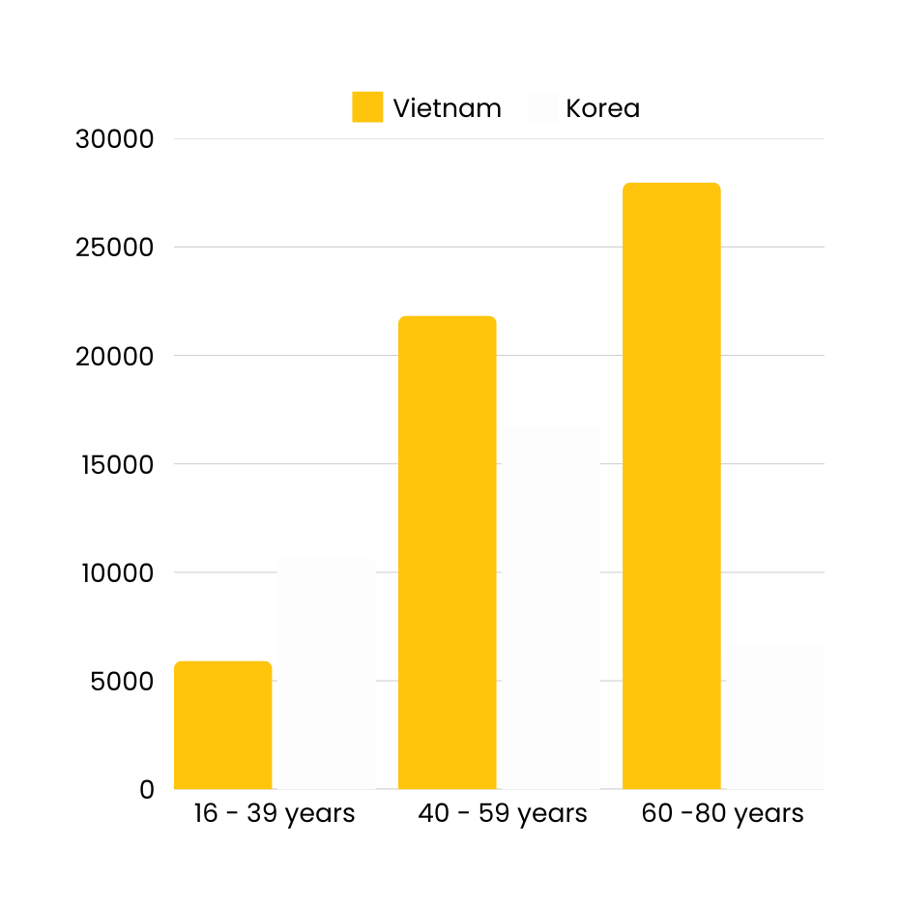
Current status in medical system
AI Curer for Vietnam
Most visited outpatients in hospital across Vietnam and S.Korea (thousand):
40 - 59
60 - 80 (Vietnam)
(Trang Chủ - Cổng Thông Tin Bộ Y Tế, 2023)
(Health Insurance Review & Assessment Service, 2023)

Slide 6







Current status in medical system
AI Curer for Vietnam
AI-powered implications outburst
(Insights10, 2022)
$0.03Bil
$0.1Bil
Vietnam AI in Healthcare market 2022
South Korea’s AI in Healthcare market 2022
(Vietnam Chatbot Marketing Market 2023 | Growth and Key Players, 2023)
(South Korea: AI Healthcare Market Size 2018-2023, n.d.)

Slide 7

AI Curer for Vietnam
Solution

Slide 8


AI CURER FOR VIETNAM
AI Curer for Vietnam
Shortened as A.C.V
Using Chat GPT 4.o Mini
AI platform for daily medical questions
Prevent unnecessary hospital visit - save your money!
No need for doctor - doctors trust A.C.V!

Slide 9


AI Curer for Vietnam
MISSION
"To provide inclusive and accessible digital healthcare solutions that empower everyone to lead healthy and happy lives."
VISION
"To become an AI-powered health management platform that eliminates Vietnam’s healthcare blind spots and supports sustainable public health systems."

Slide 10
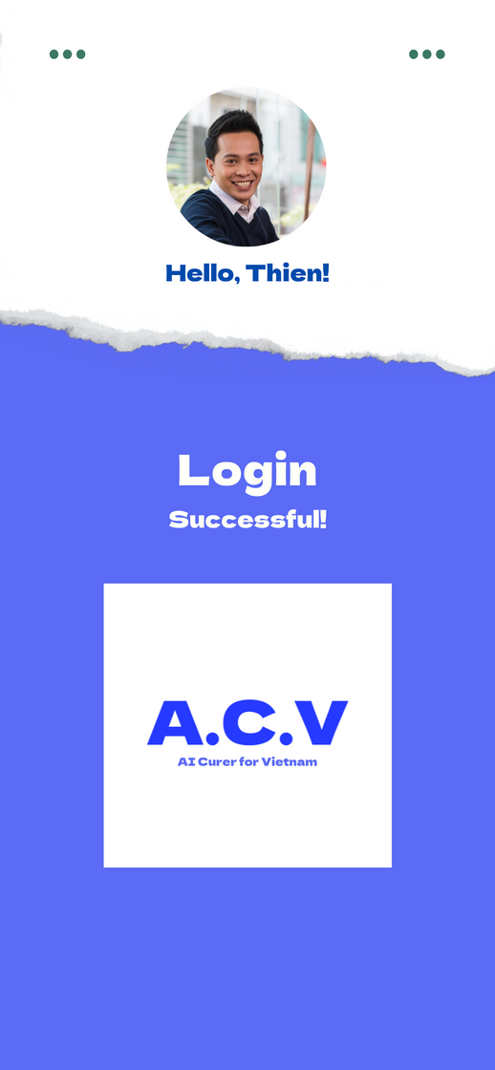
AI Curer for Vietnam
Add your profile (name, age, gender,...)
Add your medical descriptions
Sign up with phone numbers and OTTP code - You are done!
Welcome!

Slide 11


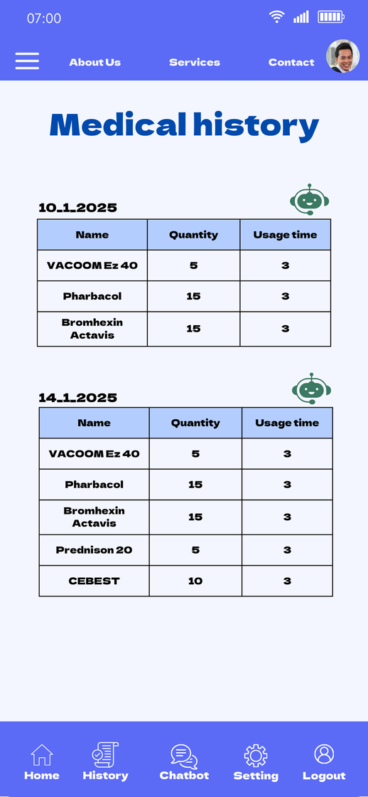
AI Curer for Vietnam
Home
Menu bar
Medical history

Slide 12
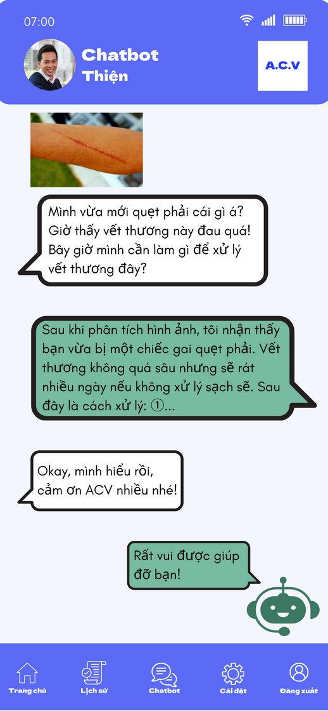
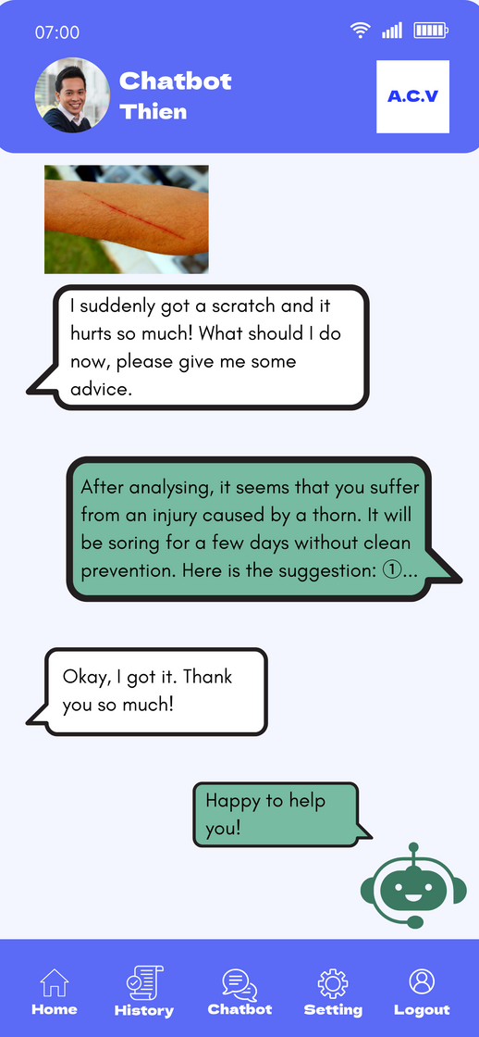
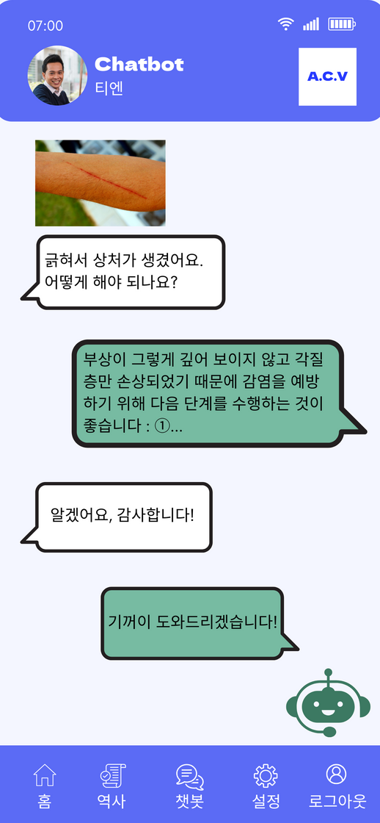
AI Curer for Vietnam
Chat with A.C.V

Slide 13
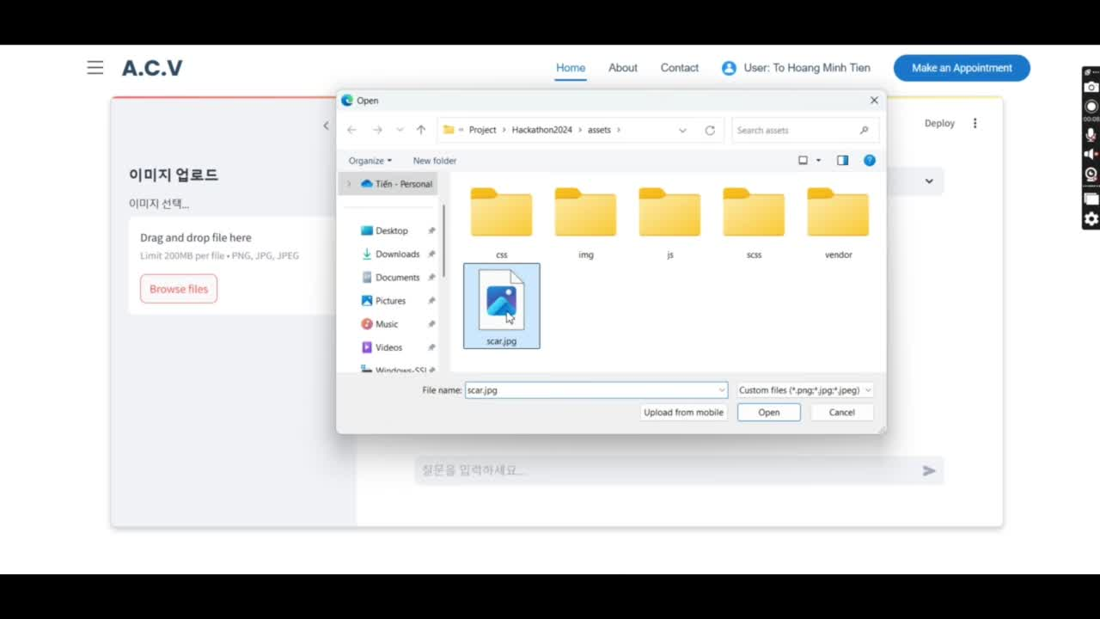
Prototype illustration
AI Curer for Vietnam

Slide 14





Unique Selling Point
AI Curer for Vietnam
Languages integration

Slide 15


Unique Selling Point
AI Curer for Vietnam
User-friendly interface
No Internet needed
Bright and catchy color - suitable for 40 years old and above
Accessible functions with buttons around the app
Big words for Baby Boomers and Gen X

Slide 16

Unique Selling Point
AI Curer for Vietnam
AI Scan
Ask and answer with its massive medical database
Based on your pills or wounds

Slide 17


How A.C.V supports
AI Curer for Vietnam
Database certified by doctors around the world → Informations are guaranteed
Supporting everyday’s medical struggle: forget to drink medicine, unable to differentiate pills, unable to understand pills’ functions

Slide 18
How A.C.V supports
AI Curer for Vietnam
A.C.V Chatbot breaks down terminology into “starter” words for users to understand their pills and wounds better, prevent hazardous situations.
Database certified by doctors around the world → Informations are guaranteed
Supporting everyday’s medical struggle: forget to drink medicine, unable to differentiate pills, unable to understand pills’ functions

Slide 19

AI Curer for Vietnam
BMC Plan

Slide 20
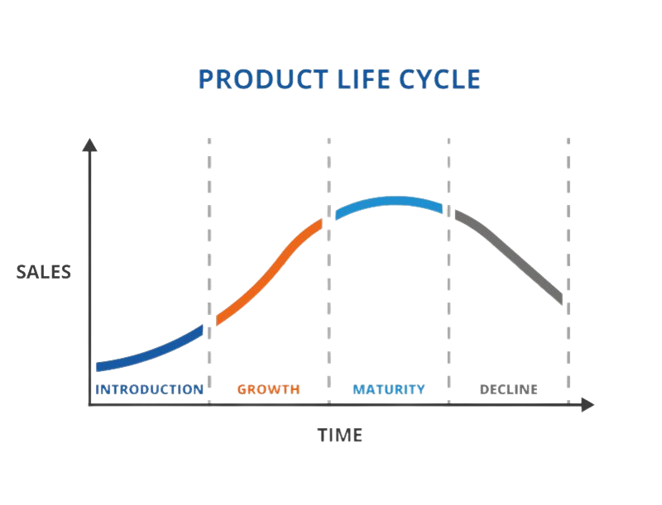

AI Curer for Vietnam
Aim to increase market recognition in Year 0 and 1
Maintain business in Year 2
New Chatbot implied across hospitals in Year 3
Long-term
(3-5 years)
Short-term
(1 year)

Slide 21
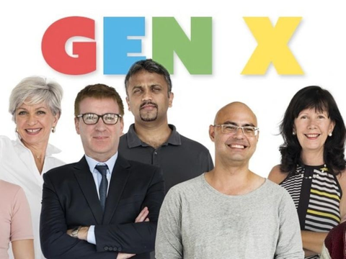



Target customers
AI Curer for Vietnam
Gen X (40 - 59):
smartphones owners
Experienced workers - take supplements and medicines everyday
Money saver
(GuardianUs, 2019)
Has a smart-phone
Hates doctors
Baby boomers (>60):
Often visit hospital for treatment
Hesitate to cure illness
Afraid of losing money unnecessary
Living in the U.S
Diep Thi Hoa - 74 years old
(GuardianUs, 2019)

Slide 22


Marketplace
AI Curer for Vietnam
Big hospitals in Vietnam:
Receives a big amount of outpatients daily
Massive medical systems with AI-powered implication (facility, machines,...)
Mass advertisement:
Through hospitals’ billboards, booths
Reliable TV shows for healthcare, TVC during breaks

Slide 23



Revenue streams
AI Curer for Vietnam
Users’ subscription/month:
Standard: $0
Premium: $9.99
Investors’ fund for running the business
Hospitals’ commissions

Slide 24

AI Curer for Vietnam
Price in the market: US$20/month (1 person/subscription)
(Ramūnas B., 2024)

Slide 25

Cost structure
AI Curer for Vietnam
Year 1
Year 3
Total cost: $3,275
Main cost: $1,842 (processing 70% Standard - 30% Premium)
Extra cost: $1,433 (Marketing focus)
Revenue: $32,384
Profit: $29,109
Total cost: $9,826
Main cost: $5,526
Extra cost: $4,300 (Salary, Bonus, facilities, continue marketing)
Revenue: $97,152
Profit: $64,768

Slide 26








Key Partners
Key Activities
Value Propotions
Customer Relationship
Customer Segments
Hospitals
Marketing
Advertisements
Bank
Vietcombank, BIDV
Open bank account for money transaction
Investors
Hospitals which are interested in collaboration
Outpatients from different hospitals within the two countries
Training courses
2-week training for new employees to get used to the system
Problem Statement: Vietnam and Korea witness a massive number of outpatients annually and mostly 40 years and above paying for unnecessary bills
We provide a digital accessible platform that can:
Support medical issues
Prevent unnecessary hospital visit
Be quick: Instant access to 24/7 medical advice, providing a sense of preparedness and reassurance in managing health concerns.
Be cost-efficient: Minimize unnecessary clinic visits, saving time and money while still addressing health issues effectively.
Be personalized: Tailored healthcare advice based on individual health history
Be advanced: Leveraging cutting-edge AI technology and trustworthy medical data to deliver accurate and reliable recommendations.
Be inclusive: Enabling access to quality healthcare services for diverse users globally.
Attract traditional customers
target at hospitals where number of outpatients are huge (early birds)
Offline direct approach
TV show for healthcares
Paid users - Outpatients from Vietnam and Korea
Gen X: 40-59 years old
Baby boomer: 60 years old and above
Usually pay a visit to the hospital
Easy to get sick because ignore small injuries
Afraid of losing too much money for healthcare
AI Curer for Vietnam
Maintain customers
Interactive and accessible digital platform
Continuous improvement (System quality, Interface,...)
Key Resources
Channels
Early adopters
Diep Thi Hoa
74 years of age
Vietnamese citizen living in the U.S - a place where medical is very expensive
Money-saver: doesn’t like spending >1,000,000 VND for medicine and hospital visits
Hates doctors because she thinks they splurge all her money
Human resources: Marketing, Finance & Accounting, Design, Sales & Customer care.
Financial resources: co-founders, loans from relatives
Tangible assets: developed systems, Chat GPT
Intangible assets: relationship
Potential of the trend: AI in implication in medical system surged after COVID-19
Online: televisions
TVC during news break, movie break
In TV show for healthcare
Offline:: big hospitals in HCMC
Be certified
Billboard advertisement
Offline sales: approach and persuade to install and use the next time
Cost Structure
Revenue Streams
From User’s subscriptions every month
Premium accounts = 50*$9.99 = $499.5 ~ 12.5M VND
From investments: sponsors, funds,... seasonally
Average total 50M VND/month
From hospitals’ commissions every month
1 successful advertisement = $42 ~ 1.1M VND
For 5 successful advertisement ~ 6M VND/month
Year 1:
Total cost = $3,275
Revenue = $32,383
Profit = $29,109
Year 2:
Total cost = $9,826
Revenue = $97,152
Profit = $64,768

Slide 27

AI Curer for Vietnam
Product limitation

Slide 28
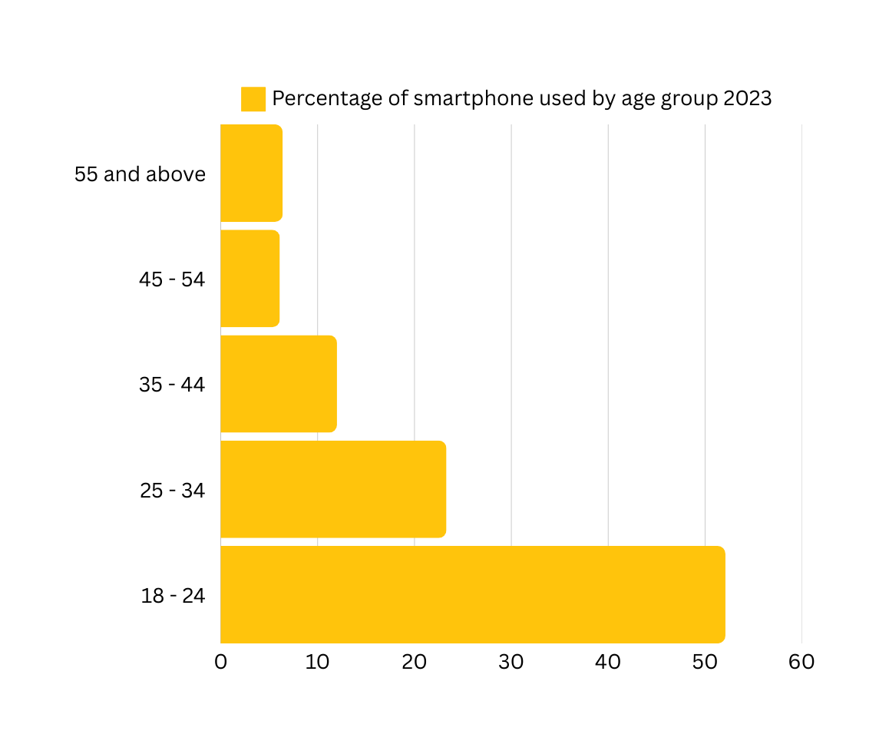
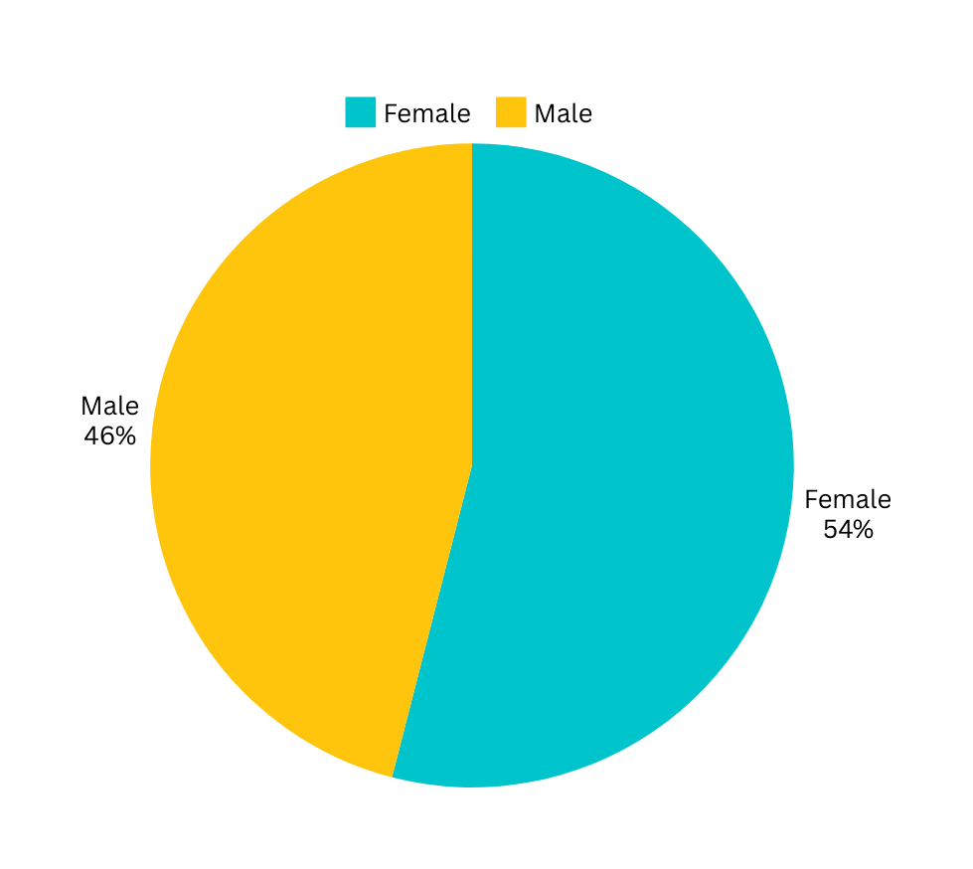
Non-smartphone users
(Smartphone Users in Vietnam Audience, 2023)

Slide 29
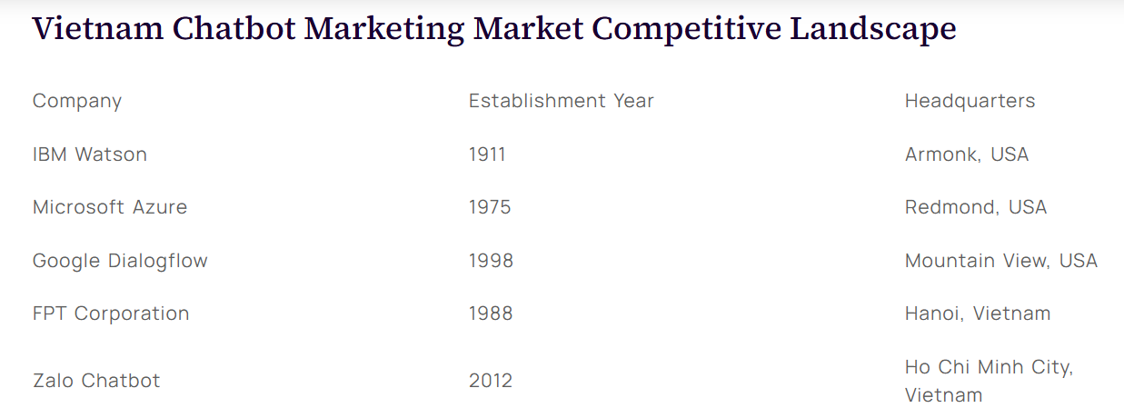
Market competition
Compete with “big players” in the market
Domestic AI system providers
Foreign MNCs
Easy enter, easy exit - bad for start-up performance
(Research, 2019)

Slide 30
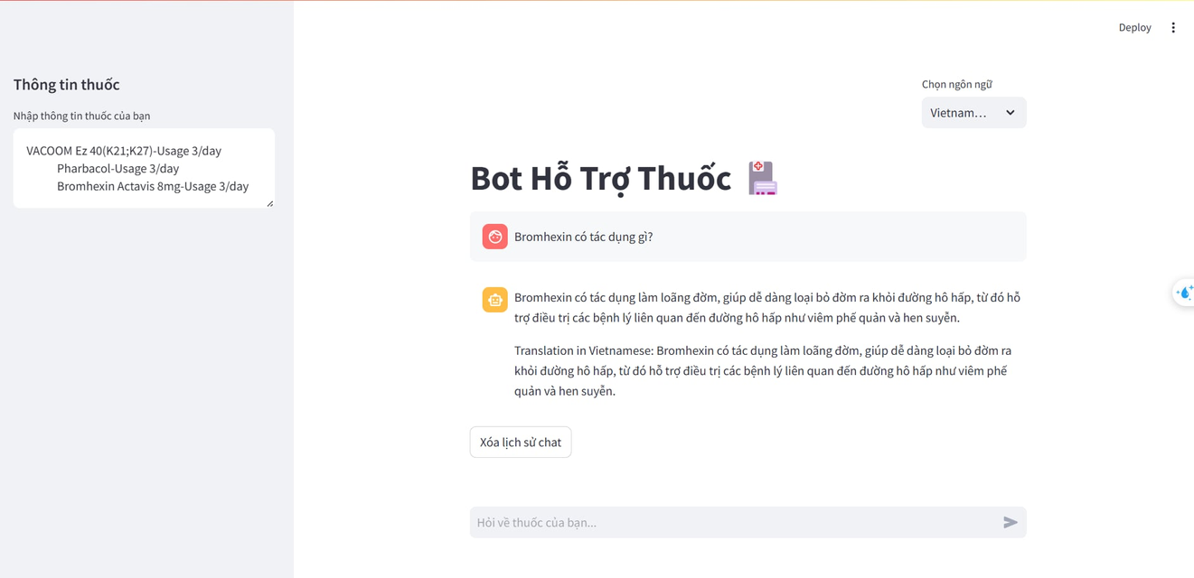
MVP in progress of finishing
Have not connected to user’s medical bill in the history

Slide 31
Reference
Datta, S., & Mukherjee, S. K. (2001). Developing a risk management matrix for effective project planning—an empirical study. Project Management Journal, 32(2), 45-57.
Herberholz, C. (2020). Risk attitude, time preference and health behaviours in the Bangkok Metropolitan Area. Journal of Behavioral and Experimental Economics, 87, 101558.
Rogers, G. O. (1997). The dynamics of risk perception: How does perceived risk respond to risk events?. Risk analysis, 17(6), 745-757.
Royer, P. S. (2000). Risk management: The undiscovered dimension of project management. Project Management Journal, 31(1), 6-13.
Selim, G., & McNamee, D. (1999). Risk management and internal auditing: what are the essential building blocks for a successful paradigm change?. International Journal of Auditing, 3(2), 147-155.
Deforestation | Green Services Direct. (2022). Greenservicesdirect.co.uk. https://www.greenservicesdirect.co.uk/deforestation
https://www.facebook.com/GuardianUs. (2019, February 17). From Greatest Generation to Racist Generation: How Baby Boomers betrayed future generations | Milwaukee Independent. Milwaukee Independent. https://www.milwaukeeindependent.com/syndicated/from-greatest-generation-to-racist-generation-how-baby-boomers-betrayed-future-generations/
Insights10. (2022). Vietnam Artificial Intelligence (AI) in Healthcare Market Analysis. Insights10.com. https://www.insights10.com/report/vietnam-artificial-intelligence-ai-in-healthcare-market-analysis/?srsltid=AfmBOopd3C0kyzdNuQ7c5XNUFiPw3U1dUx7ezVG-WIXypAdaqS6EEpzK
Khuê Trần. (2019, June 3). Người ta có thể sản xuất được bao nhiêu giấy từ một cái cây nhỉ? Đáp án đây này. Https://Kenh14.Vn. https://kenh14.vn/nguoi-ta-co-the-san-xuat-duoc-bao-nhieu-giay-tu-mot-cai-cay-nhi-dap-an-day-nay-20190602212526827.chn
Ramūnas Berkmanas. (2024, August 26). Chatbot Development Cost In 2024. EasyFlow. https://easyflow.tech/chatbot-development-cost/
Research. (2019). Healthcare Chatbots Market Size, Share & Forecast to 2030. Researchandmarkets.com. https://www.researchandmarkets.com/report/healthcare-chatbot?srsltid=AfmBOop8QqWGg6GQsy3HY6AGBaWKuj6jzYDD7X85rklDG6hMgvpWqoab
ScaleFocus. (2024). The Cost of Implementing AI in Healthcare: Key Insights I Scalefocus. Scalefocus. https://www.scalefocus.com/blog/the-cost-of-implementing-ai-in-healthcare-key-insights
South Korea: AI healthcare market size 2018-2023. (n.d.). Statista. https://www.statista.com/statistics/1131669/south-korea-ai-healthcare-market-size/
Start.io | Smartphone Users in Vietnam Audience. (2023). Start.io. https://www.start.io/audience/smartphone-users-in-vietnam
Thi Thao Nguyen, S., Yamamoto, E., Thi Ngoc Nguyen, M., Bao Le, H., Kariya, T., Mon Saw, Y., Duc Nguyen, C., & Hamajima, N. (2018). Waiting time in the outpatient clinic at a national hospital in Vietnam. Nagoya Journal of Medical Science, 80(2), 227–239. https://doi.org/10.18999/nagjms.80.2.227
Trang chủ - Cổng thông tin Bộ Y tế. (2021). Moh.gov.vn. https://moh.gov.vn/
Vietnam Chatbot Marketing Market 2023 | Growth and Key Players. (2023). Kenresearch.com. https://www.kenresearch.com/industry-reports/vietnam-chatbot-marketing-market

Slide 32

GLOBAL HACKATHON 2025
Thank you for your attention!
Q&A Session

Slide 33

AI Curer for Vietnam
Appendix

Slide 34
RISK IDENTIFICATION
(Herberholz, 2020)
RISK IDENTIFICATION | CONSEQUENCES
Broad idea | Lead to unclear team’s objectives for the product and unclear structure for the whole project
Team’s unable to generate a prototype for the product | Unpractical presentation because without a prototype, audience cannot understand
Communication barrier | Lack of mutual understanding, ideas and opinions might be under-transferred, team unable to work cohesively
Unclear presentation content | Lead to unclear deliveries and underperformance of team
Time management skill is decreased | Unable to submit slides on time, can lead to stress and team conflict
Lack of synergy between members | Miscommunication of ideas

Slide 35
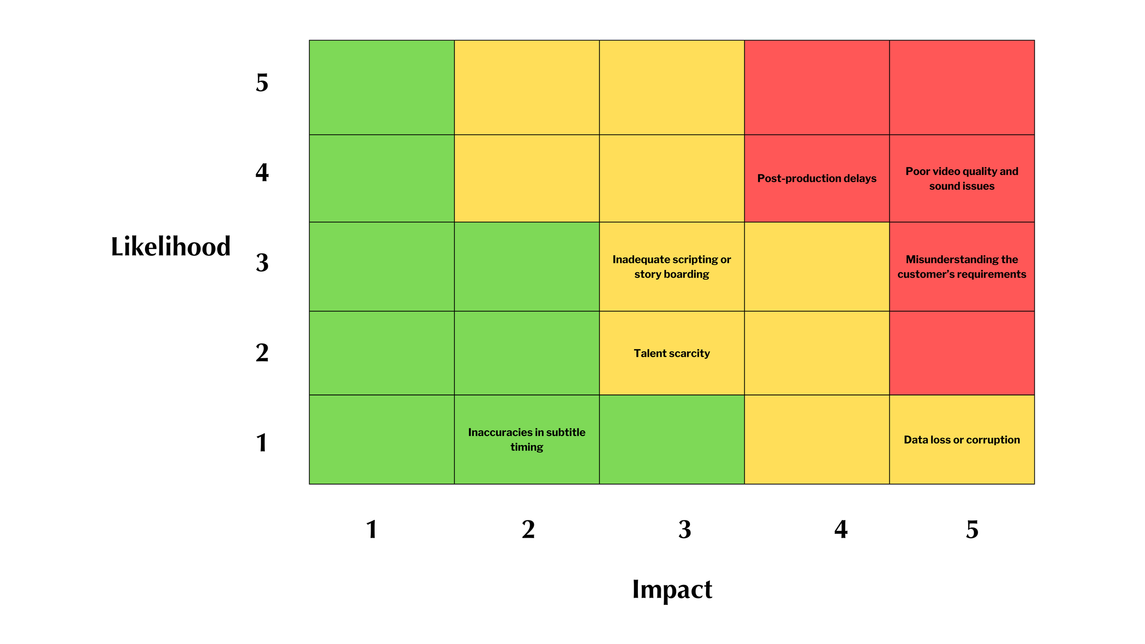
RISK SEVERITY MATRIX
Broad idea
lack of synergy
Low
Communication barrier
Time management is decreased
Medium
High
Team unable to generate a prototype
Unclear presentation content
(Royer, 2000)

Slide 36
RISK RESPONSE MATRIX
(Datta et al., 2001)
RISK EVENTS | RESPONSES | CONTIGENCY PLAN | TRIGGERS | P.I.C
Broad idea | Use bottom-up method: start from the customer and then climb up to the big picture of the story | Support from mentor: asking for idea references and steps to generate ideas | Broad topic, team’s careless consideration for ideas | Team
Team’s unable to generate a prototype for the product | Divide tasks - 2 IT-majored members discuss and work together | The other 2 non-IT members responsible for evaluating the appearance, color, giving more comments on the prototype | A finished prototype needed longer than 3 days to run smoothly | Tien, Hyeon
Communication barrier | Speak simple English, using notes, translators, hand gestures and body languages to describe. Very time-consuming | Ask for support from the mentor - translate our ideas into the other language | Vietnamese member who is not good at English, so do Korean members | Team

Slide 37
RISK RESPONSE MATRIX
(Datta et al., 2001)
RISK EVENTS | RESPONSES | CONTIGENCY PLAN | TRIGGERS | P.I.C
Unclear presentation content | From the start-up idea, draw an BMC to visualise what are needed to say | Look up content for pitching online and take reference from them | Not enough members to discuss about the content | Nhien, Jong
Time management skill is decreased | Chop down tasks - what are needed to be done first and what are not the priority | Do easy things first, difficult things will have more time to be solved and discussed | Team is loaded with too many tasks | Team
Lack of synergy between members | casually ask and support each other, making sure both sides know what to do | Write names on the tasks that needed to be done and make brief descriptions for the tasks | Divided skills - IT and non-IT making it difficult to integrate dicussions | Team

